Slide 1
Models and Architectures

Slide 2
Objectives
Learn the basic design of a computer graphics system
Introduce graphics pipeline architecture
Examine software components for an interactive graphics system

Slide 3
Image Formation Revisited
Can we mimic the synthetic camera model to design graphics hardware software?
Application Programmer Interface (API)
Need only specify
Objects
Materials
Viewer
Lights
But how is the API implemented?

Slide 4
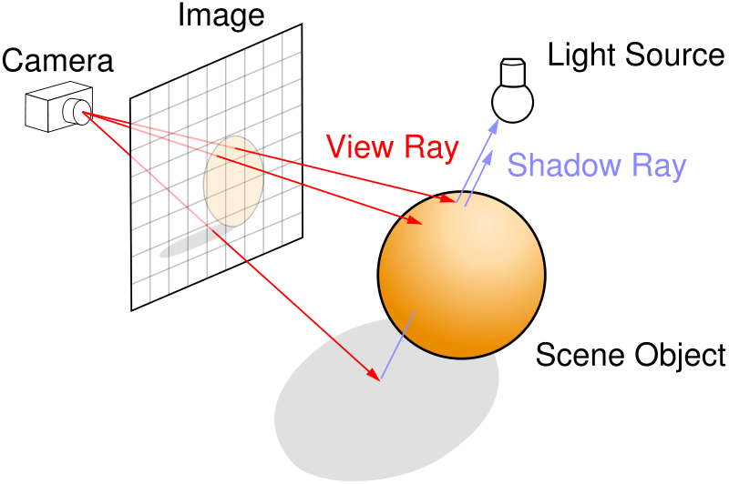
Physical Approaches
Ray tracing: follow rays of light from center of projection until they either are absorbed by objects or go off to infinity
Can handle global effects
Multiple reflections
Translucent objects
Computationally slow
Very realistic images

Slide 5
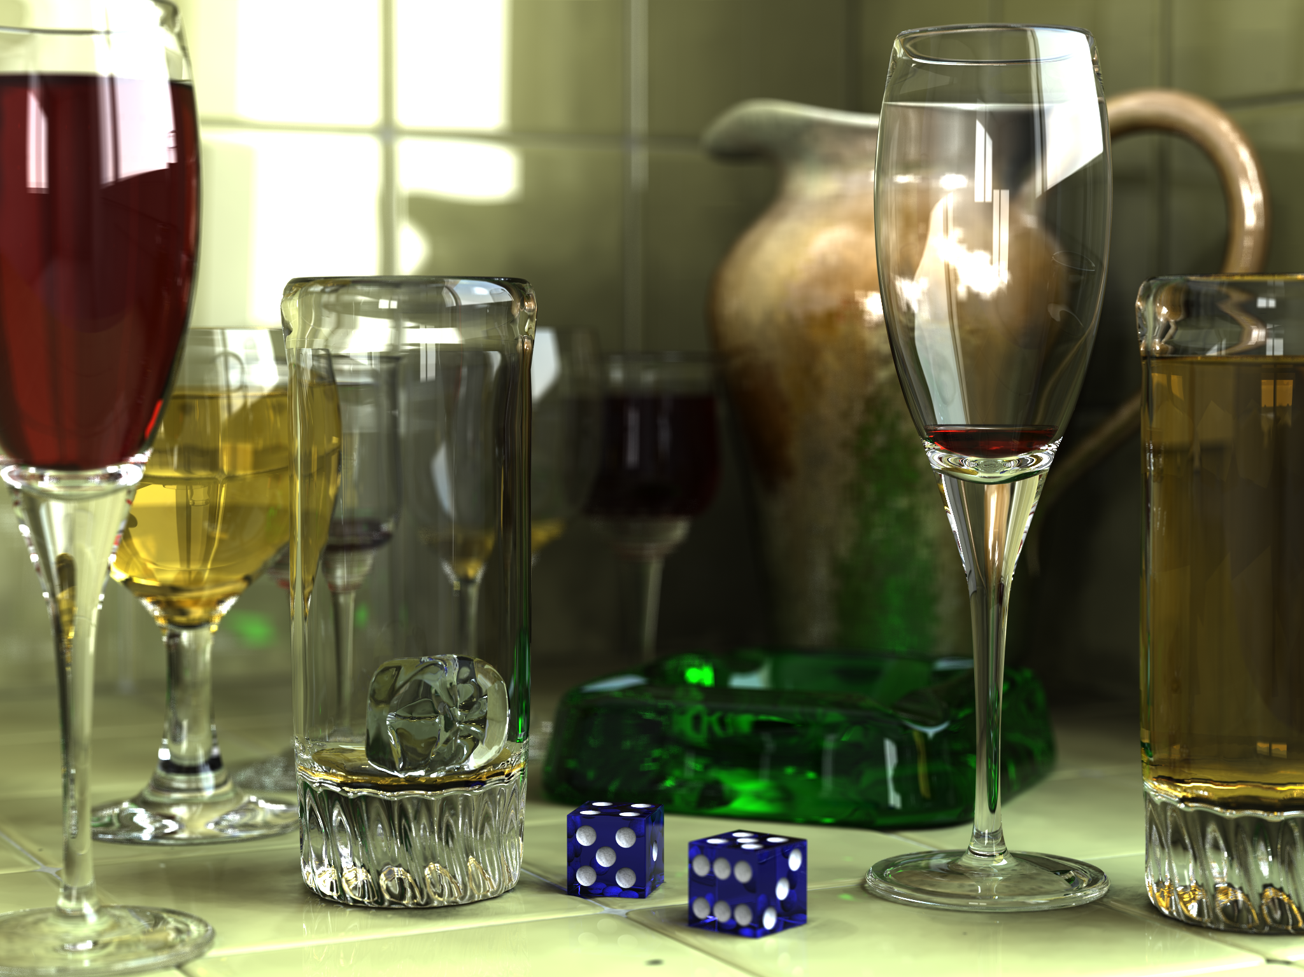
Ray Tracing Example
Angel: Interactive Computer Graphics 5E © Addison-Wesley 2009
5

Slide 6
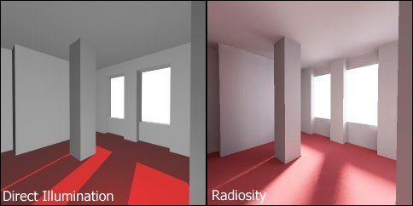
Physical Approaches
Radiosity: Uses finite element methods to solve the rendering equation for scenes with purely diffuse surfaces
Start with direct illumination image
Calculate reflections between all objects in scene
Iterate until illumination image reaches steady state
Angel: Interactive Computer Graphics 5E © Addison-Wesley 2009
6

Slide 7
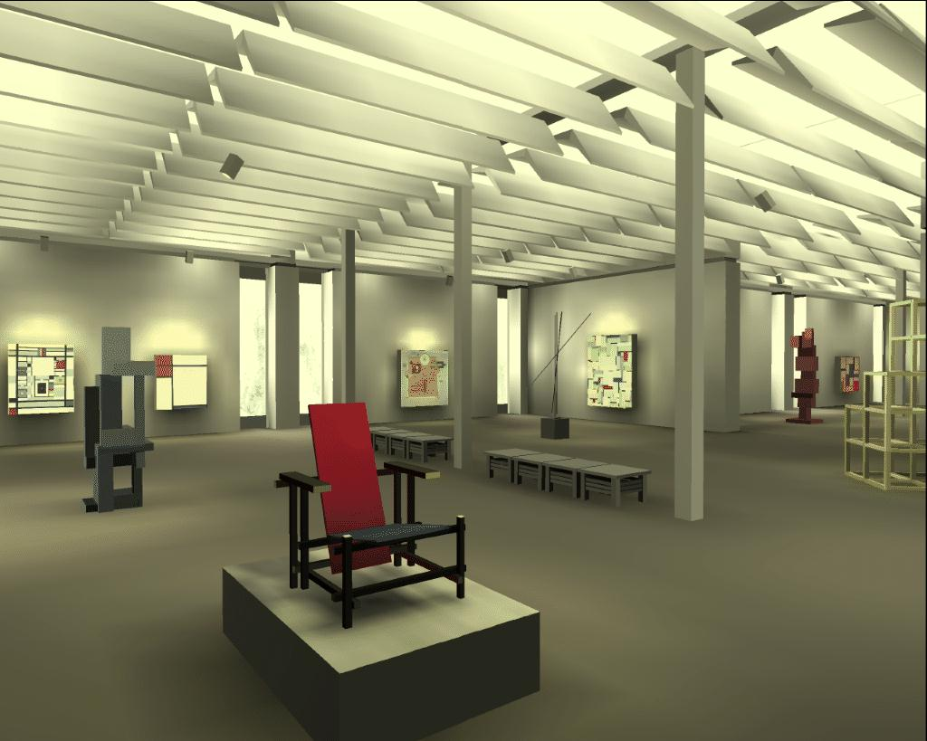
Radiosity Example
Angel: Interactive Computer Graphics 5E © Addison-Wesley 2009
7

Slide 8
Practical Approach
Pipeline architecture: process objects one at a time in the order they are generated by the application
Can consider only local lighting
Can implement in software or hardware
application
program
display

Slide 9
Vertex Processing
Much of the work in the pipeline is in converting object representations from one coordinate system to another
Object coordinates
Camera (eye) coordinates
Screen coordinates
Every change of coordinates is equivalent to a matrix transformation
Vertex processor also computes vertex colors

Slide 10
Projection
Projection is the process that combines the 3D viewer with the 3D objects to produce the 2D image
Perspective projections: all projectors meet at the center of projection
Parallel projection: projectors are parallel, center of projection is replaced by a direction of projection

Slide 11
Primitive Assembly
Vertices must be collected into geometric objects before clipping and rasterization can take place
Line segments
Polygons
Curves and surfaces

Slide 12
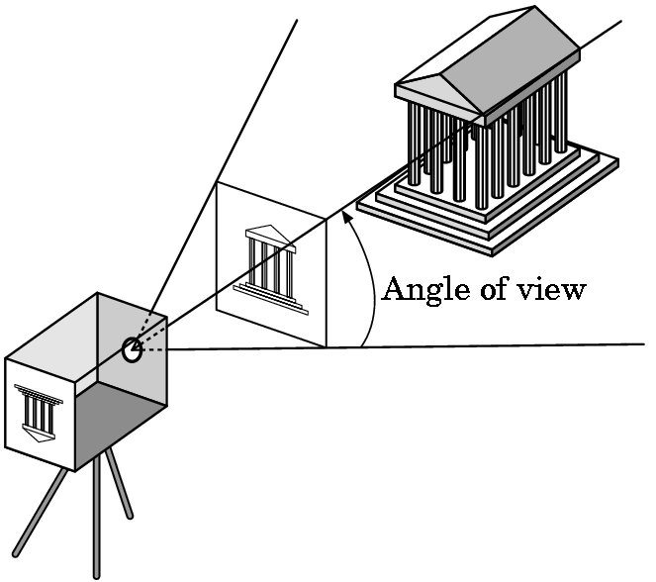
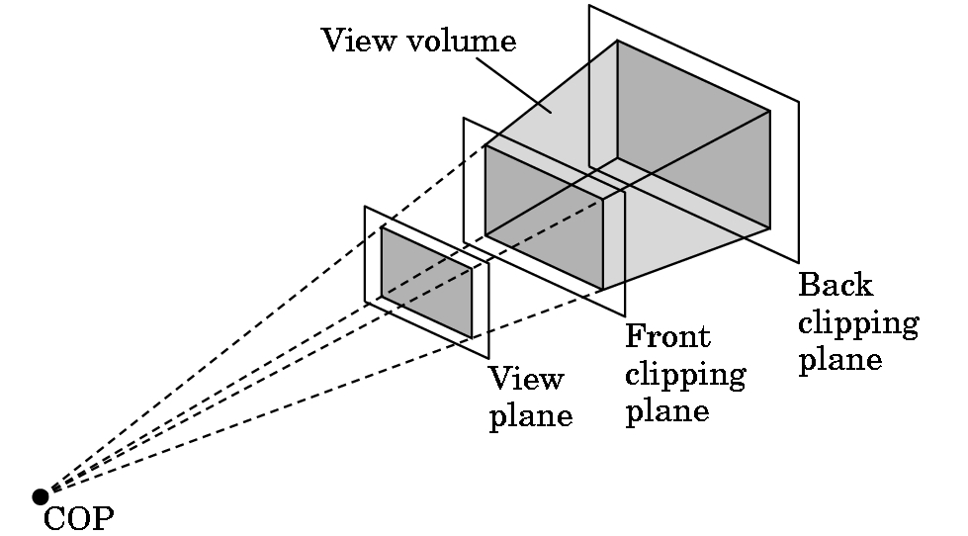
Clipping
Just as a real camera cannot “see” the whole world, the virtual camera can only see part of the world or object space
Objects that are not within this volume are said to be clipped out of the scene

Slide 13
Rasterization
If an object is not clipped out, the appropriate pixels in the frame buffer must be assigned colors
Rasterizer produces a set of fragments for each object
Fragments are “potential pixels”
Have a location in frame bufffer
Color and depth attributes
Vertex attributes are interpolated over objects by the rasterizer

Slide 14
Fragment Processing
Fragments are processed to determine the color of the corresponding pixel in the frame buffer
Colors can be determined by texture mapping or interpolation of vertex colors
Fragments may be blocked by other fragments closer to the camera
Hidden-surface removal

Slide 15
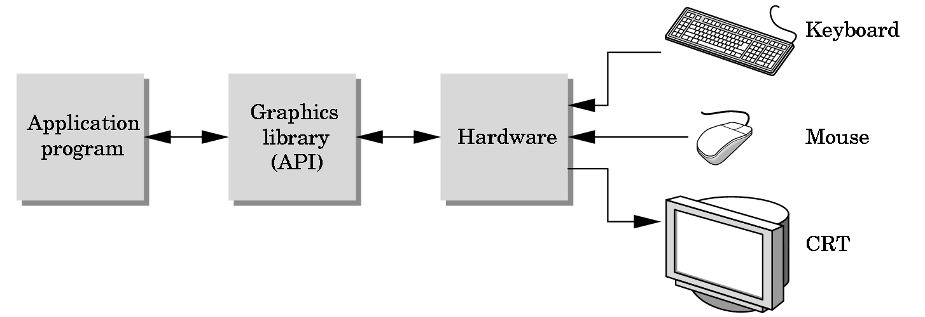
The Programmer’s Interface
Programmer sees the graphics system through a software interface: the Application Programmer Interface (API)

Slide 16
API Contents
Functions that specify what we need to form an image
Objects
Viewer
Light Source(s)
Materials
Other information
Input from devices such as mouse and keyboard
Capabilities of system

Slide 17
Object Specification
Most APIs support a limited set of primitives including
Points (0D object)
Line segments (1D objects)
Polygons (2D objects)
Some curves and surfaces
Quadrics
Parametric polynomials
All are defined through locations in space or vertices

Slide 18
Example
type of object
location of vertex
glBegin(GL_POLYGON)
glVertex3f(0.0, 0.0, 0.0);
glVertex3f(0.0, 1.0, 0.0);
glVertex3f(0.0, 0.0, 1.0);
glEnd( );
end of object definition

Slide 19
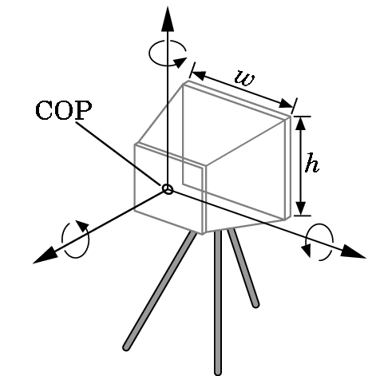
Camera Specification
Six degrees of freedom
Position of center of lens
Orientation
Lens
Film size
Orientation of film plane

Slide 20
Lights and Materials
Types of lights
Point sources vs distributed sources
Spot lights
Near and far sources
Color properties
Material properties
Absorption: color properties
Scattering
Diffuse
Specular

